Slide 1

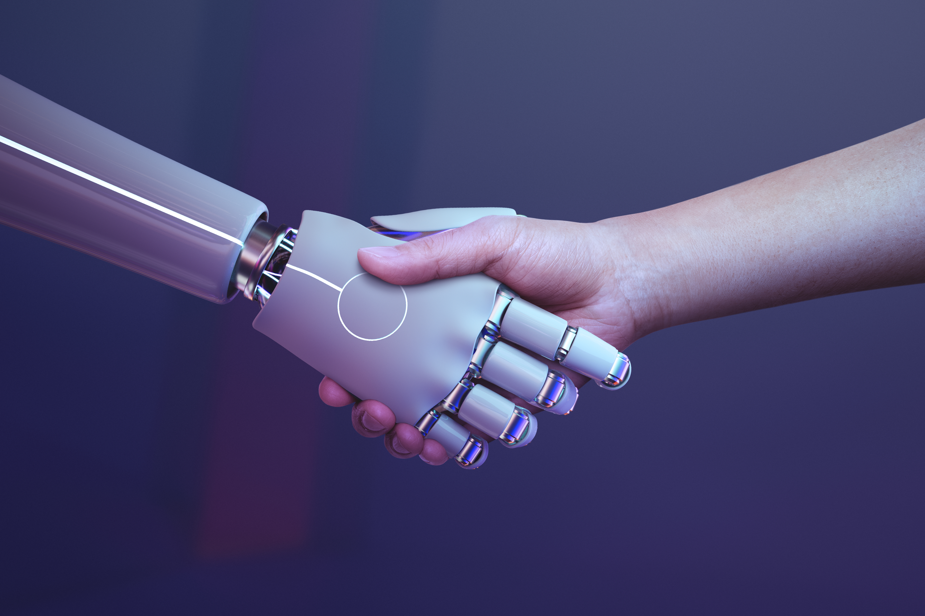
LLMs
LLMs
How to use LLMs
Some Interesting Tips
Large Language Models
Q&A
Ryan Heida
AI.Mastery.Student

Slide 3

ChatGPT
was trained
on over 300 billion words!

Slide 4

ChatGPT
was trained
on over 300 billion words!
LLMs Timeline
Pre-Transformer
1990 - 2017
RNN, LSTM, NMT, ELMo model
Transformer
2017 - 2018
The rise of Transformers - No specific LLMs Yet…
Post-Transformer
2018 - Present
GPT-1, BERT – GPT-2, XLNet – GPT3, T5 - BLOOM, Codex, GPT-4

Slide 5
ChatGPT
was trained
on over 300 billion words!
LLMs Timeline
Pre-Transformer
1990 - 2017
RNN, LSTM, NMT, ELMo model
Transformer
2017 - 2018
The rise of Transformers - No specific LLMs Yet…
Post-Transformer
2018 - Present
GPT-1, BERT – GPT-2, XLNet – GPT3, T5 - BLOOM, Codex, GPT-4

Slide 6
LLMs Timeline
Pre-Transformer
1990 - 2017
RNN, LSTM, NMT, ELMo model
Transformer
2017 - 2018
The rise of Transformers - No specific LLMs Yet…
Post-Transformer
2018 - Present
GPT-1, BERT – GPT-2, XLNet – GPT3, T5 - BLOOM, Codex, GPT-4

Slide 7
LLMs Timeline
Pre-Transformer
1990 - 2017
RNN, LSTM, NMT, ELMo model
Transformer
2017 - 2018
The rise of Transformers - No specific LLMs Yet…
Post-Transformer
2018 - Present
GPT-1, BERT – GPT-2, XLNet – GPT3, T5 - BLOOM, Codex, GPT-4

Slide 8
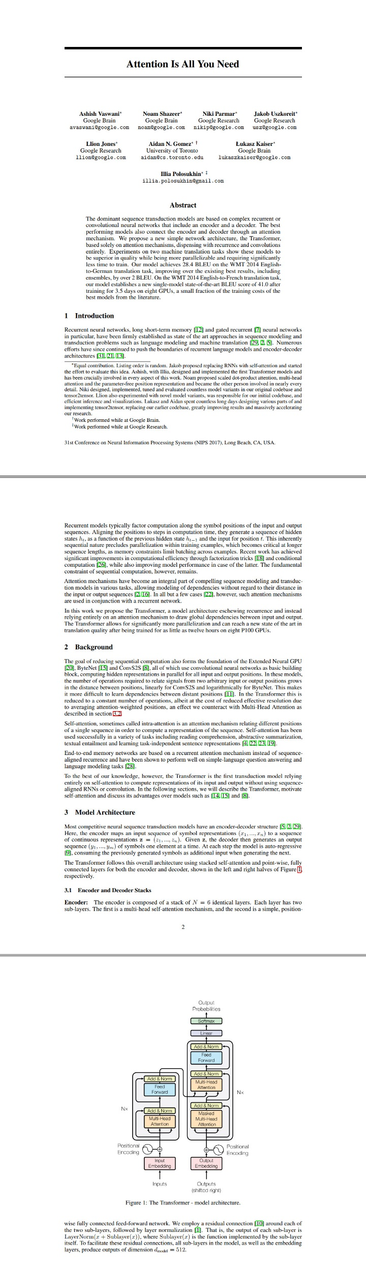
LLMs Timeline
Pre-Transformer
1990 - 2017
RNN, LSTM, NMT, ELMo model
Transformer
2017 - 2018
The rise of Transformers - No specific LLMs Yet…
Post-Transformer
2018 - Present
GPT-1, BERT – GPT-2, XLNet – GPT3, T5 - BLOOM, Codex, GPT-4

Slide 9
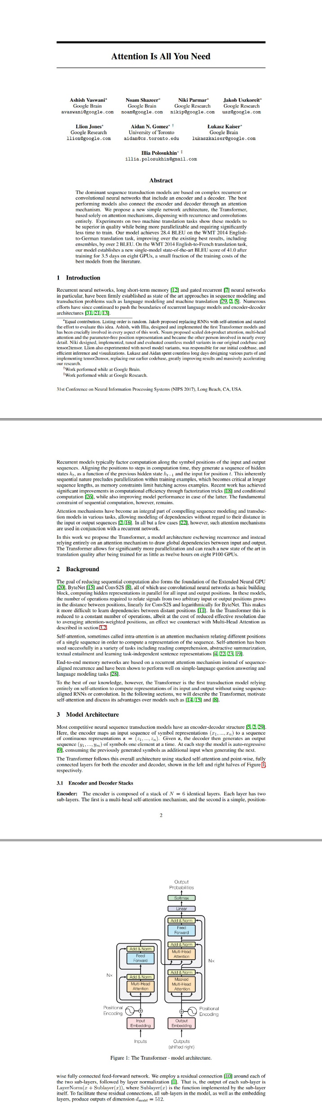
Attention Is All You Need
LLMs Timeline
Pre-Transformer
1990 - 2017
RNN, LSTM, NMT, ELMo model
Transformer
2017 - 2018
The rise of Transformers - No specific LLMs Yet…
Post-Transformer
2018 - Present
GPT-1, BERT – GPT-2, XLNet – GPT3, T5 - BLOOM, Codex, GPT-4

Slide 10
Attention Is All You Need
LLMs Timeline
Pre-Transformer
1990 - 2017
RNN, LSTM, NMT, ELMo model
Transformer
2017 - 2018
The rise of Transformers - No specific LLMs Yet…
Post-Transformer
2018 - Present
GPT-1, BERT – GPT-2, XLNet – GPT3, T5 - BLOOM, Codex, GPT-4

Slide 11
Why Are LLMs Transformative?
Speed
Scale
Intelligence
Process and analyze
vast amounts of text
in seconds.
Operate in
multiple languages
and domains.
Generate creative, coherent,
and useful content.

Slide 12
Why Are LLMs Transformative?
Speed
Scale
Intelligence
Process and analyze
vast amounts of text
in seconds.
Operate in
multiple languages
and domains.
Generate creative, coherent,
and useful content.

Slide 13
Why Are LLMs Transformative?
Speed
Scale
Intelligence
Process and analyze
vast amounts of text
in seconds.
Operate in
multiple languages
and domains.
Generate creative, coherent,
and useful content.

Slide 14
LLMs in Everyday Life
Why Are LLMs Transformative?
Speed
Scale
Intelligence
Process and analyze
vast amounts of text
in seconds.
Operate in
multiple languages
and domains.
Generate creative, coherent,
and useful content.

Slide 15
Why Are LLaMs Transformative?
LLMs in Everyday Life
AI Assistants
Content Creation
Customer Support
Siri
Alexa
ChatGPT
Articles
Code
even poetry
Smarter chatbots
and faster solutions

Slide 16
LLMs in Everyday Life
AI Assistants
Content Creation
Customer Support
Siri
Alexa
ChatGPT
Articles
Code
even poetry
Smarter chatbots
and faster solutions

Slide 17
LLMs in Everyday Life
AI Assistants
Content Creation
Customer Support
Siri
Alexa
ChatGPT
Articles
Code
even poetry
Smarter chatbots
and faster solutions

Slide 18
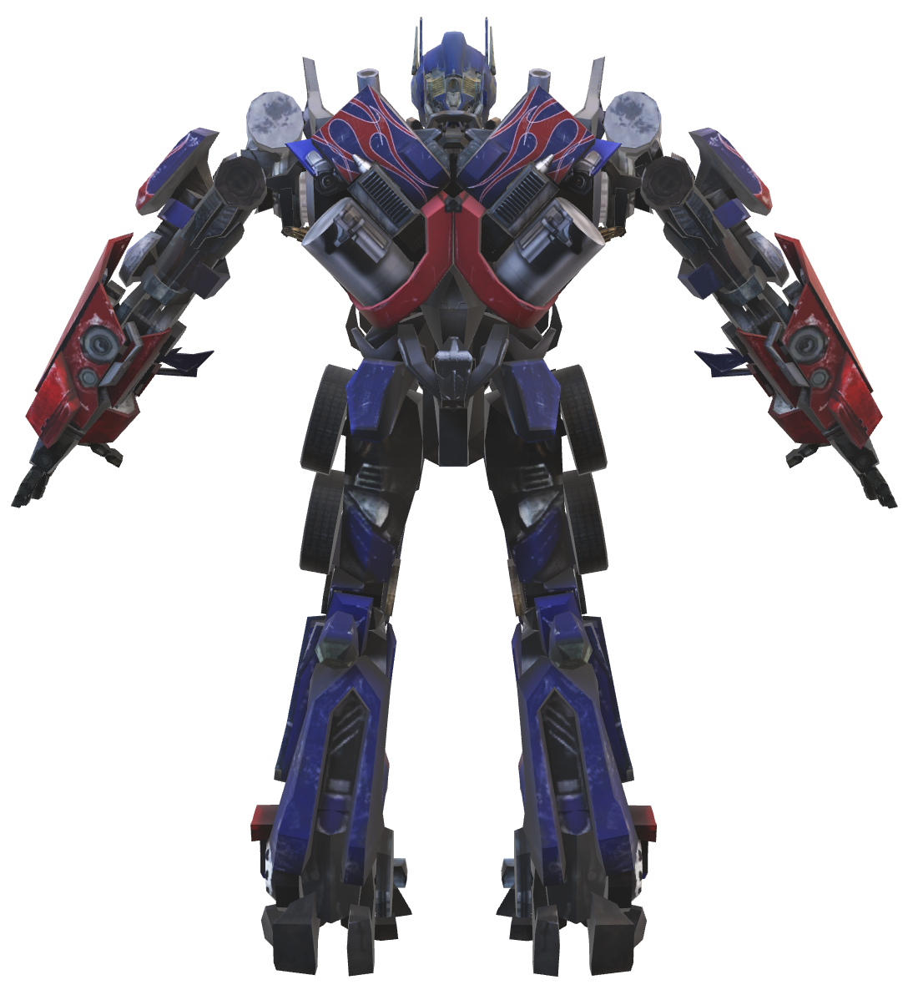
LLMs in Everyday Life
AI Assistants
Content Creation
Customer Support
Siri
Alexa
ChatGPT
Articles
Code
even poetry
Smarter chatbots
and faster solutions

Slide 19
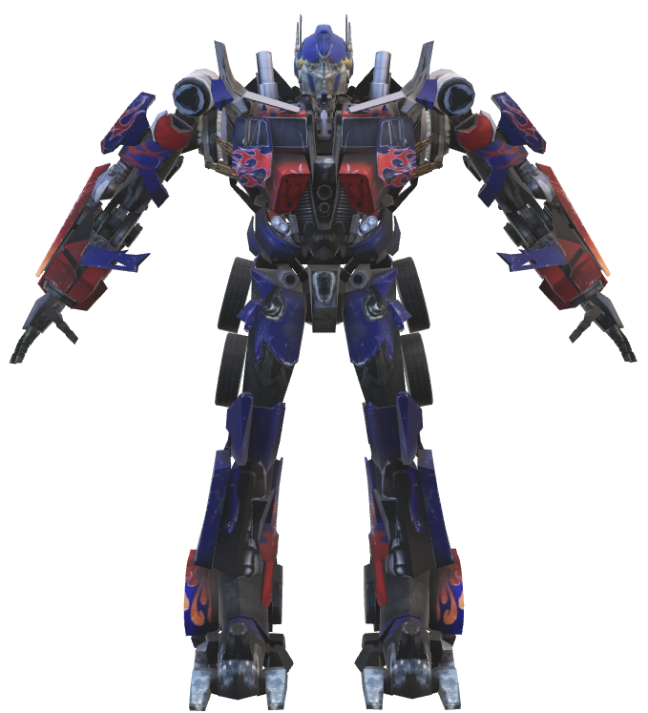
How LLMs Work
Next Word Prediction
INPUT
OUTPUT

Slide 20
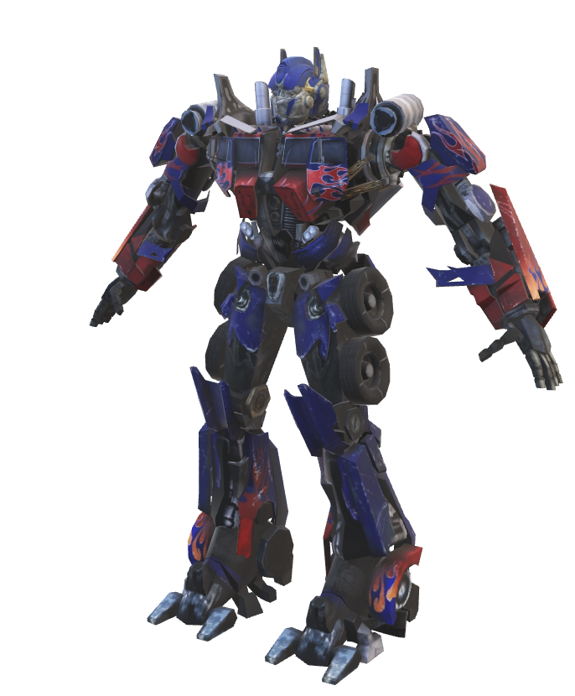
How LLMs Work
Next Word Prediction
The Car is ----

Slide 21
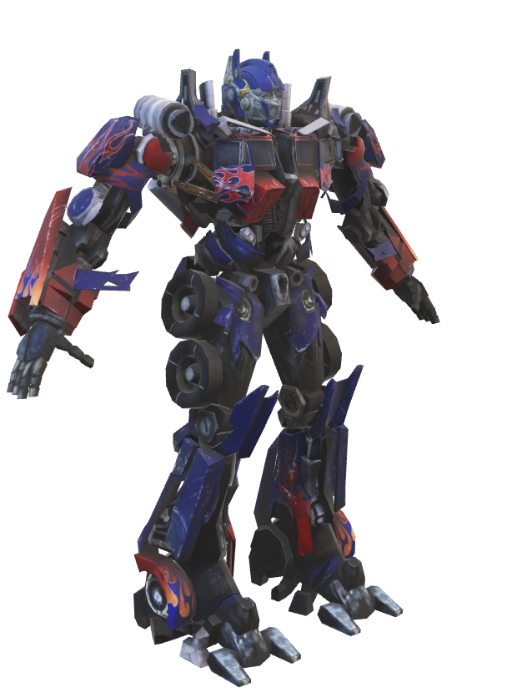
How LLMs Work
Next Word Prediction
The Car is ----
Red

Slide 22
How LLMs Work
Next Word Prediction
The Car is red
Red

Slide 23

How LLMs Work
Next Word Prediction
Tell a story.

Slide 24
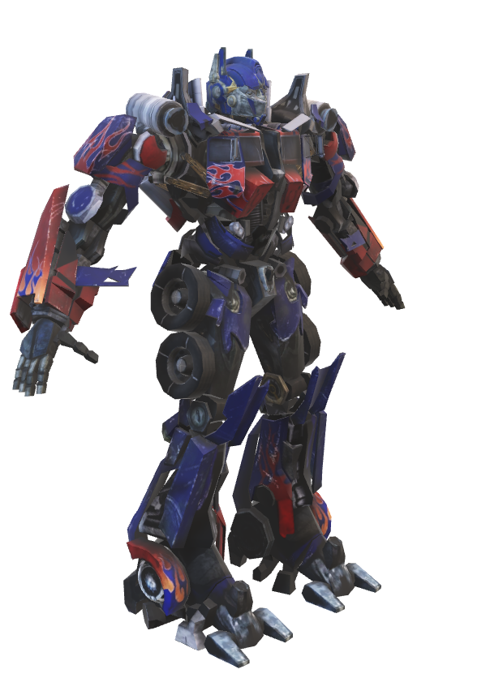
How LLMs Work
Next Word Prediction
Tell a story.
Once

Slide 25

How LLMs Work
Next Word Prediction
Tell a story.
Once

Slide 26
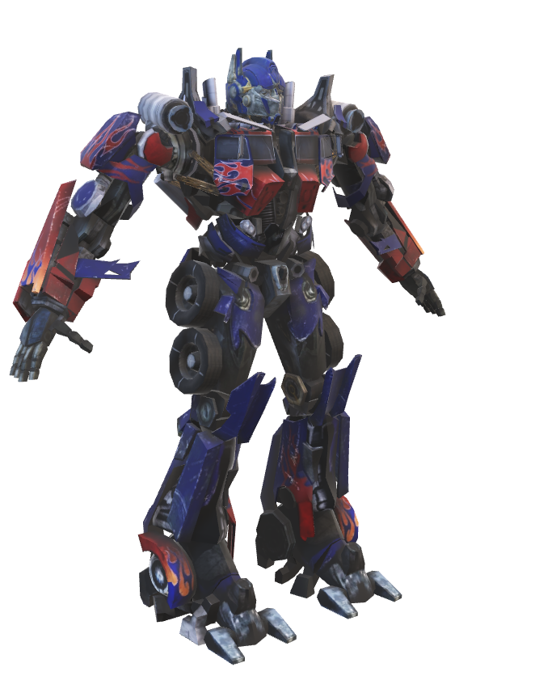
How LLMs Work
Next Word Prediction
Tell a story.
Once
upon

Slide 27

How LLMs Work
Next Word Prediction
Tell a story.
Once
upon

Slide 28
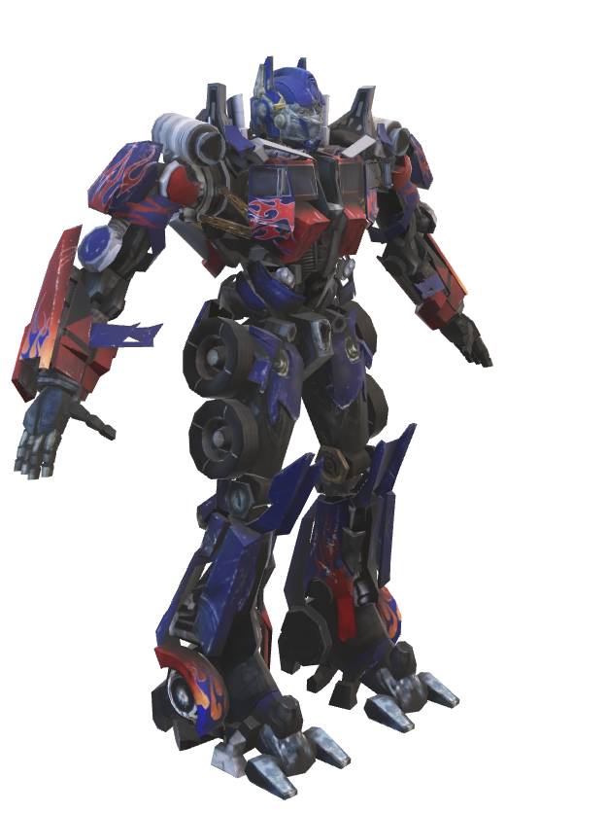
How LLMs Work
Next Word Prediction
Tell a story.
Once
upon
a time

Slide 29
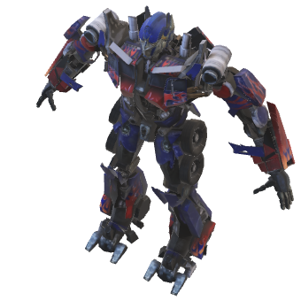
How LLMs Work
Next Word Prediction
Tell a story.
Once
upon
a time
………

Slide 30
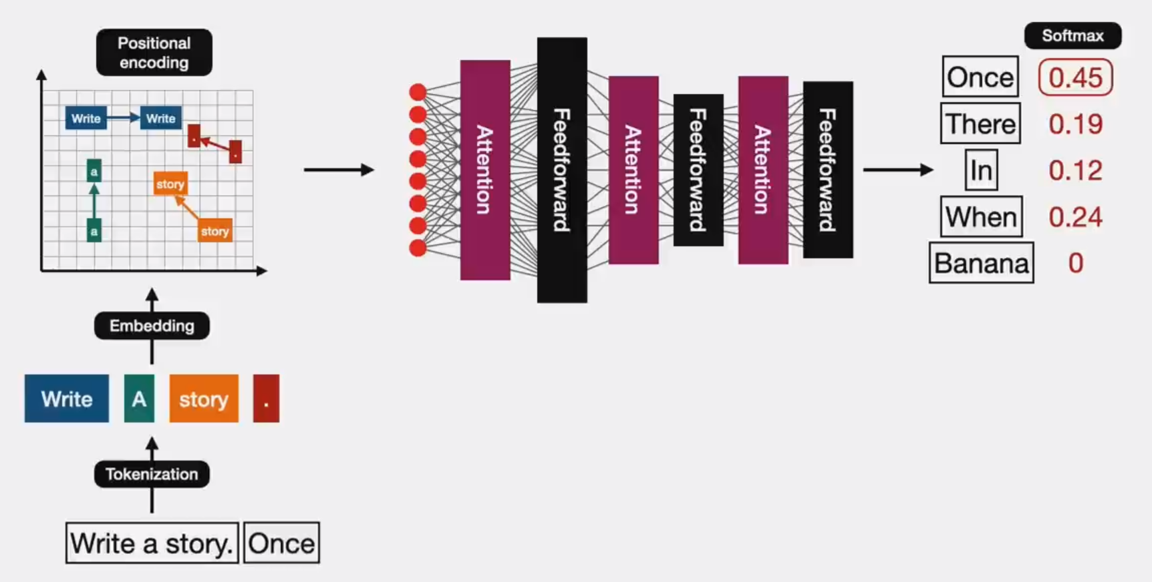
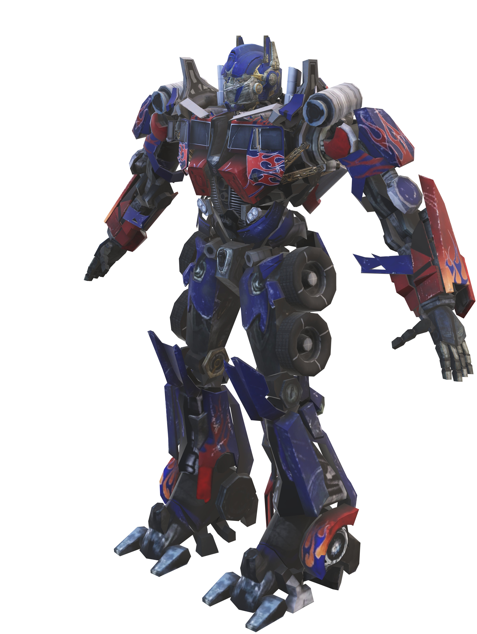
How LLMs Work
A little deeper

Slide 31
How LLMs Work
A little deeper

Slide 32
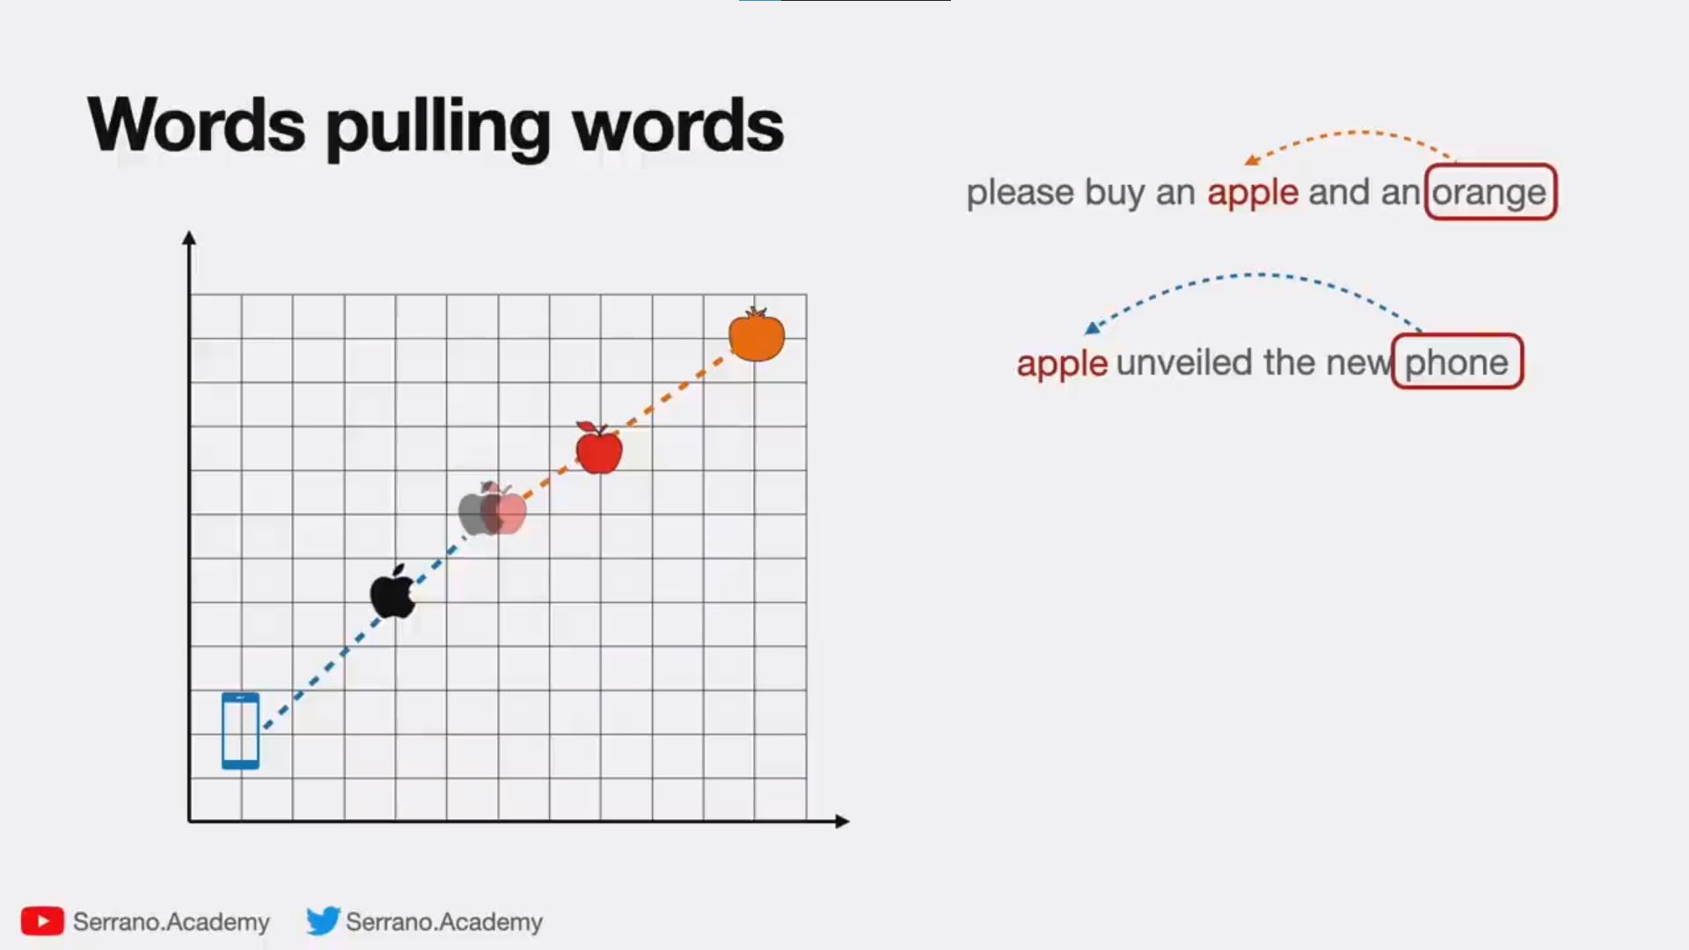


Slide 33
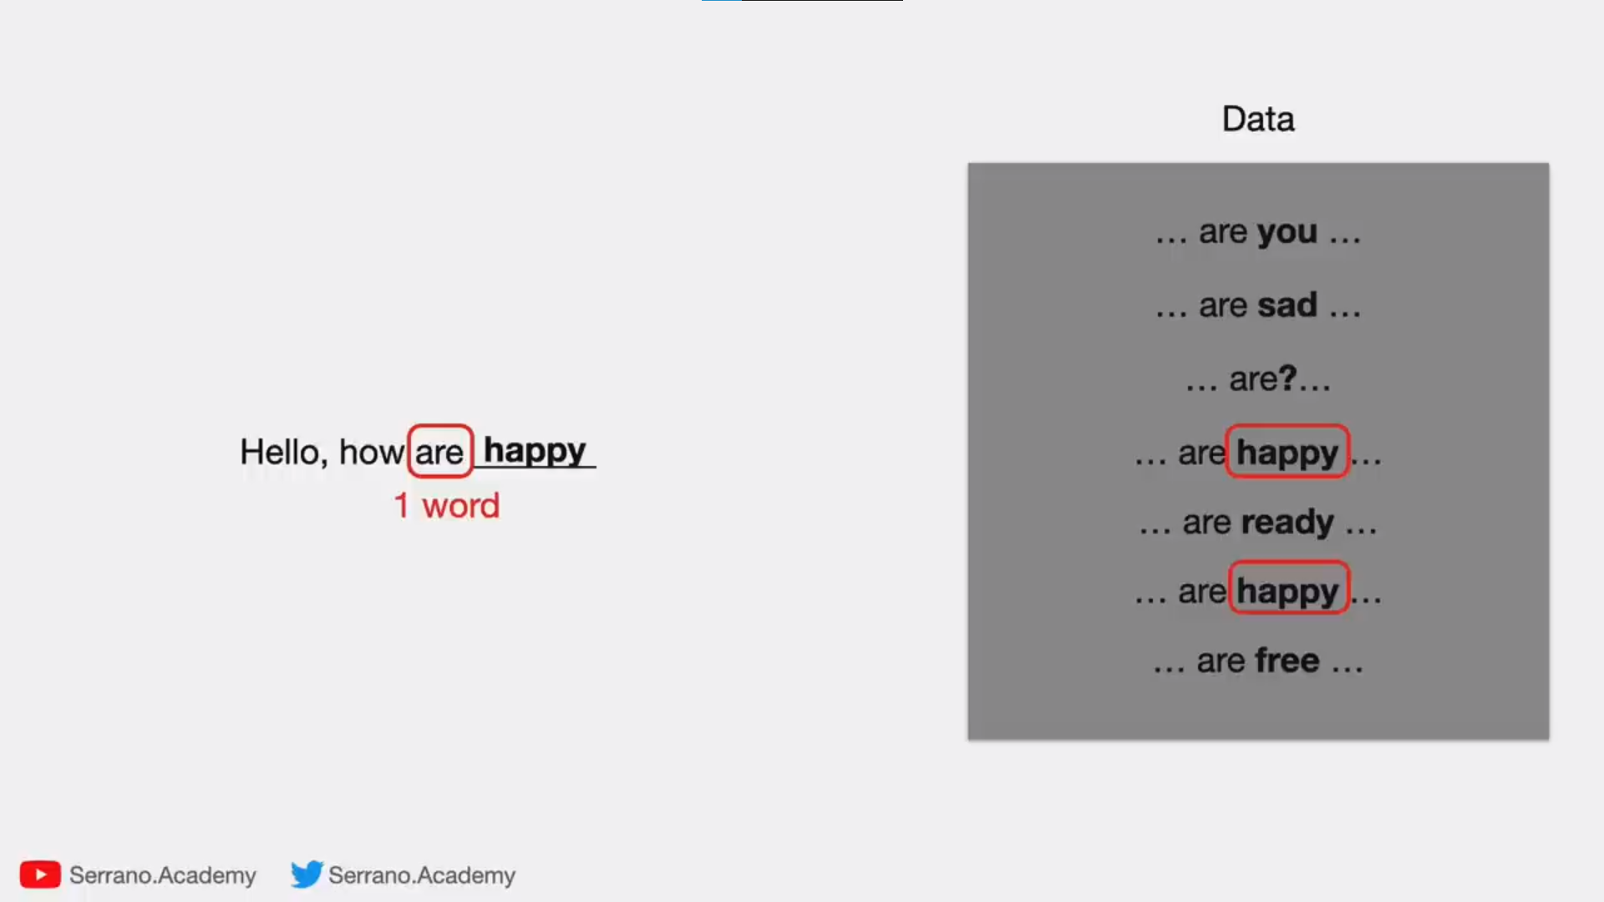
1-gram

Slide 34
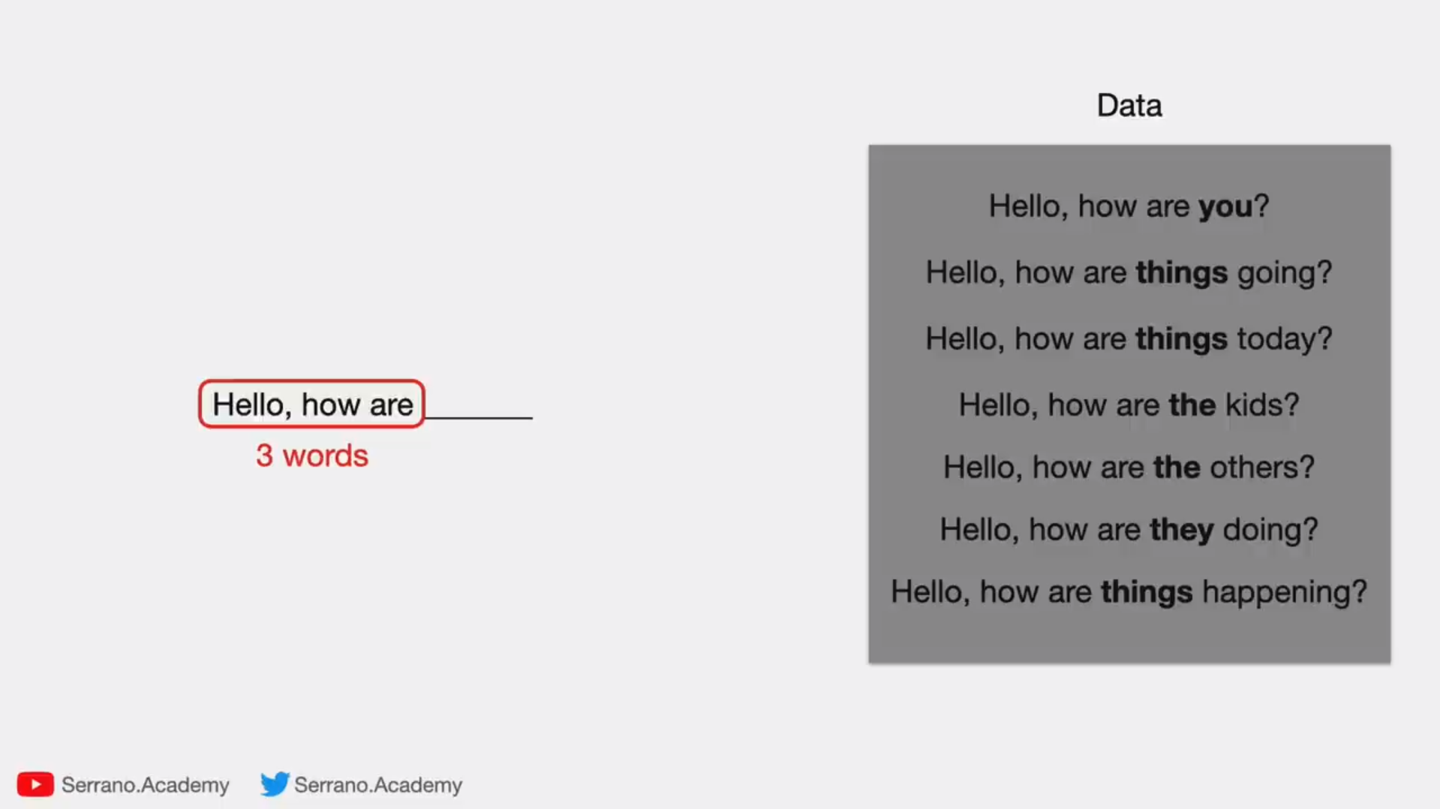
3-gram

Slide 35
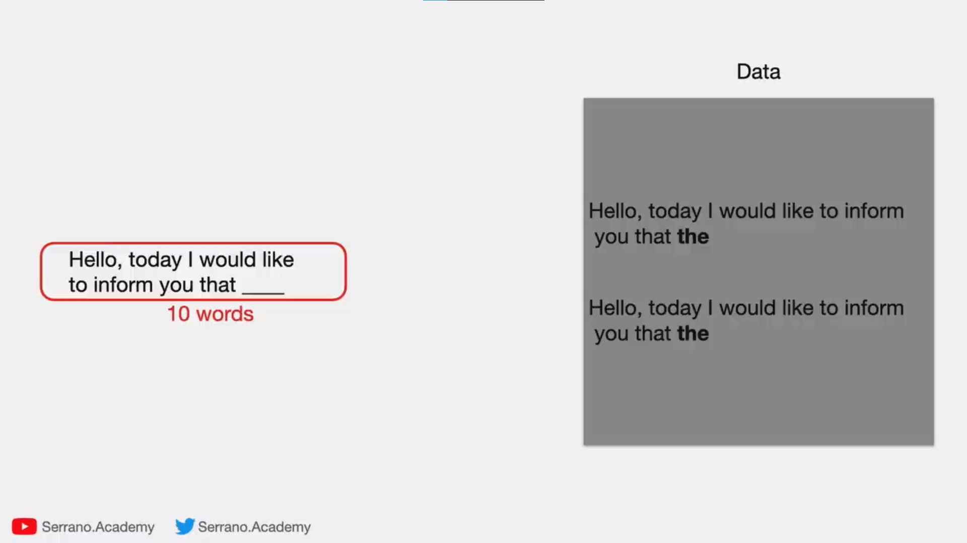
10-gram

Slide 36
Transformers
Key Components
Input Embeddings: Convert text to numerical vectors.
Positional Encoding: Capture the order of words.
Self-Attention Layers: Highlight relationships between words.
Feedforward Neural Network: Process attention outputs into meaningful patterns.
Result: Complex understanding of long-range dependencies.

Slide 37
Transformers
Key Components
Input Embeddings: Convert text to numerical vectors.
Positional Encoding: Capture the order of words.
Self-Attention Layers: Highlight relationships between words.
Feedforward Neural Network: Process attention outputs into meaningful patterns.
Result: Complex understanding of long-range dependencies.

Slide 38
Transformers
Key Components
Input Embeddings: Convert text to numerical vectors.
Positional Encoding: Capture the order of words.
Self-Attention Layers: Highlight relationships between words.
Feedforward Neural Network: Process attention outputs into meaningful patterns.
Result: Complex understanding of long-range dependencies.

Slide 39
Transformers
Key Components
Input Embeddings: Convert text to numerical vectors.
Positional Encoding: Capture the order of words.
Self-Attention Layers: Highlight relationships between words.
Feedforward Neural Network: Process attention outputs into meaningful patterns.
Result: Complex understanding of long-range dependencies.

Slide 40
Transformers
Key Components
Input Embeddings: Convert text to numerical vectors.
Positional Encoding: Capture the order of words.
Self-Attention Layers: Highlight relationships between words.
Feedforward Neural Network: Process attention outputs into meaningful patterns.
Result: Complex understanding of long-range dependencies.

Slide 41
Transformers
Key Components
Input Embeddings: Convert text to numerical vectors.
Positional Encoding: Capture the order of words.
Self-Attention Layers: Highlight relationships between words.
Feedforward Neural Network: Process attention outputs into meaningful patterns.
Result: Complex understanding of long-range dependencies.

Slide 42
What Can’t LLMs Do?
Lack of True Understanding
Dependence on Input Phrasing
Hallucinations and Fabrication
LLMs don’t "understand" text the way humans do.
They rely on statistical patterns in data rather than reasoning or comprehension.
Resource Intensive
Bias in Outputs
Limited Domain-Specific Expertise
Ethical and Security Concerns

Slide 43
What Can’t LLMs Do?
Lack of True Understanding
Dependence on Input Phrasing
Hallucinations and Fabrication
Resource Intensive
LLMs are sensitive to the wording of prompts, which can drastically affect their output.
Bias in Outputs
Limited Domain-Specific Expertise
Ethical and Security Concerns

Slide 44
What Can’t LLMs Do?
Lack of True Understanding
Dependence on Input Phrasing
Hallucinations and Fabrication
Resource Intensive
Bias in Outputs
LLMs can "hallucinate" facts,
generating entirely false or misleading information with confidence.
😂
Limited Domain-Specific Expertise
Ethical and Security Concerns

Slide 45
What Can’t LLMs Do?
Dependence on Input Phrasing
Lack of True Understanding
Hallucinations and Fabrication
Resource Intensive
Bias in Outputs
Limited Domain-Specific Expertise
LLMs require vast computational resources for training and inference.
Ethical and Security Concerns

Slide 46
What Can’t LLMs Do?
Lack of True Understanding
Hallucinations and Fabrication
Dependence on Input Phrasing
Resource Intensive
Bias in Outputs
Limited Domain-Specific Expertise
Ethical and Security Concerns
LLMs inherit biases present in their training data,
which can lead to unfair or inappropriate outputs.

Slide 47
What Can’t LLMs Do?
Lack of True Understanding
Hallucinations and Fabrication
Resource Intensive
Dependence on Input Phrasing
Bias in Outputs
Limited Domain-Specific Expertise
Ethical and Security Concerns
While LLMs are generalists,
they may struggle with highly specialized tasks without fine-tuning.

Slide 48
What Can’t LLMs Do?
Lack of True Understanding
Hallucinations and Fabrication
Resource Intensive
Bias in Outputs
Dependence on Input Phrasing
Limited Domain-Specific Expertise
Ethical and Security Concerns
LLMs can be misused to generate harmful content like misinformation,
phishing attacks, or deepfakes.

Slide 49
Ethical and Security Concerns

Slide 50


Ethical and Security Concerns
A summery of “An Overview of Artificial Intelligence Ethics” article
1
2
3
4
A global review of 146 AI ethics guidelines, highlighting key principles like transparency, fairness, and accountability.
A categorization of AI ethical issues at individual, societal, and environmental levels.
A review of approaches to address ethical issues, including ethical, technological, and legal strategies.
A discussion on the challenges in implementing ethical AI and future directions for research.

Slide 51
Ethical and Security Concerns
A summery of “An Overview of Artificial Intelligence Ethics” article
2
3
4
1
A global review of 146 AI ethics guidelines, highlighting key principles like transparency, fairness, and accountability.
A review of approaches to address ethical issues, including ethical, technological, and legal strategies.
A discussion on the challenges in implementing ethical AI and future directions for research.
A categorization of AI ethical issues at individual, societal, and environmental levels.

Slide 52
Ethical and Security Concerns
A summery of “An Overview of Artificial Intelligence Ethics” article
3
4
1
2
A global review of 146 AI ethics guidelines, highlighting key principles like transparency, fairness, and accountability.
A review of approaches to address ethical issues, including ethical, technological, and legal strategies.
A discussion on the challenges in implementing ethical AI and future directions for research.
A categorization of AI ethical issues at individual, societal, and environmental levels.

Slide 53
Ethical and Security Concerns
A summery of “An Overview of Artificial Intelligence Ethics” article
4
1
2
3
A global review of 146 AI ethics guidelines, highlighting key principles like transparency, fairness, and accountability.
A discussion on the challenges in implementing ethical AI and future directions for research.
A categorization of AI ethical issues at individual, societal, and environmental levels.
A review of approaches to address ethical issues, including ethical, technological, and legal strategies.

Slide 54
Ethical and Security Concerns
A summery of “An Overview of Artificial Intelligence Ethics” article
1
2
3
4
A global review of 146 AI ethics guidelines, highlighting key principles like transparency, fairness, and accountability.
A categorization of AI ethical issues at individual, societal, and environmental levels.
A review of approaches to address ethical issues, including ethical, technological, and legal strategies.
A discussion on the challenges in implementing ethical AI and future directions for research.

Slide 55

Ethical and Security Concerns
A summery of “An Overview of Artificial Intelligence Ethics” article
https://github.com/Ryan-Heida-Translations/fa-An-Overview-of-Artificial-Intelligence-Ethics
1
2
3
4
A global review of 146 AI ethics guidelines, highlighting key principles like transparency, fairness, and accountability.
A categorization of AI ethical issues at individual, societal, and environmental levels.
A review of approaches to address ethical issues, including ethical, technological, and legal strategies.
A discussion on the challenges in implementing ethical AI and future directions for research.

Slide 56

Have you ever tried GPT o1-preview in voice chat?

Slide 57


Slide 62


LLMs we can use…
Open-Source
APIs
Hugging Face
GPT-3
GPT-4
Codex
Claude
Llama

Slide 63
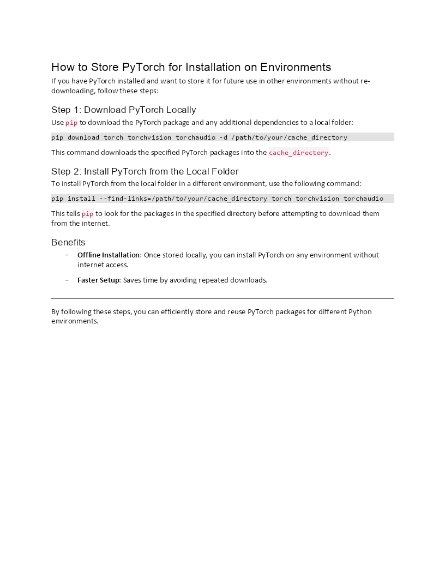

Questions
PyTorch Offline Installation
https://gist.github.com/Ryan-PG/9b5198e099bf77f33e94e13a434acf89

Slide 64
Questions
Differences between python packages
PyTorch و TensorFlow/Keras بیشتر برای مدل‌های یادگیری عمیق مناسب هستند. PyTorch برای تحقیق و توسعه، و TensorFlow برای تولید.
Scikit-Learn برای الگوریتم‌های کلاسیک یادگیری ماشین و کارهای سبک‌تر استفاده می‌شود.
XGBoost برای مدل‌های درختی و تحلیل آماری محبوب است.
MXNet به‌دلیل قابلیت توزیع‌پذیری و پشتیبانی از گراف‌های پویا، برای مدل‌هایی که به اجرا در سطح وسیع نیاز دارند، مناسب است.

Slide 65
Hands on code…
Transformers, StreamLit, Ollama, G4F

Slide 66
RAGs and Crew AI

Slide 67
Large language models are not just tools of innovation.
They are a reflection of our collective knowledge and creativity, guiding us toward a future limited only by our imagination.
مدل‌های زبانی بزرگ فقط ابزار نوآوری نیستند.
آنها انعکاسی از دانش و خلاقیت جمعی ما هستند و ما را به سوی آینده ای هدایت می کنند که فقط توسط تخیل ما محدود می‌شود.

Slide 68
References & Continue
Hugging Face Tutorial
What Are Transformers
Transformers
What are Transformer Models and how do they work?
An Overview of Artificial Intelligence Ethics - Persian Translation

Slide 69
My Recommendations…

Slide 70

links.ryanheida.com

Slide 71


Slide 72
Thanks
For Watching

